Slide 1
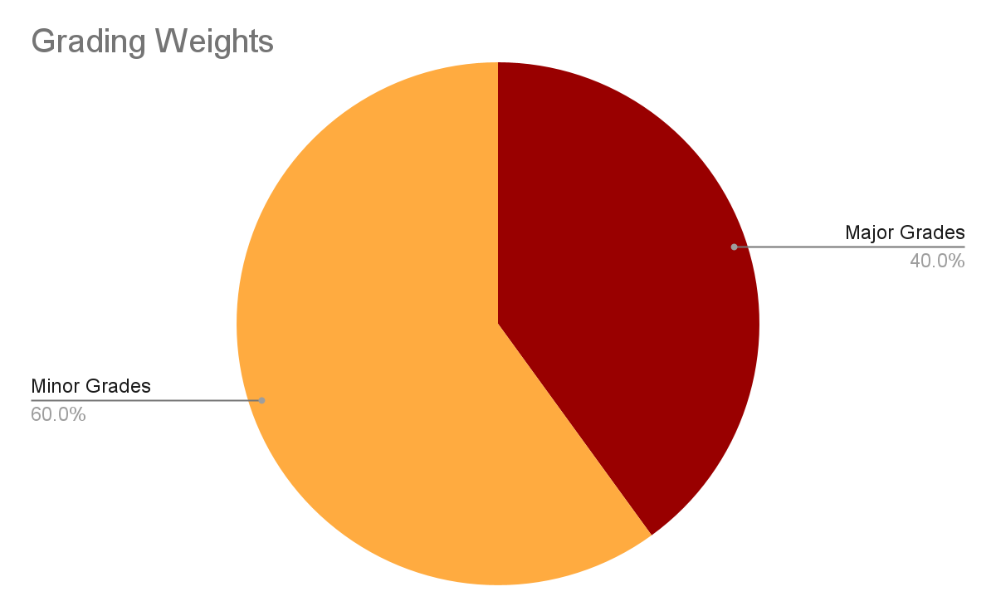
Geometry Summer Learning Experience
Motto: Lock In! Class participation is an important aspect of student learning. When students speak up in class, they learn to express their ideas mathematically. Additionally, asking questions helps students to obtain information that’ll enhance their own understanding. We have 19 days to work effectively and efficiently. Therefore, students will be graded on mastery of the standard through class participation as well as class work. Homework may be given periodically with the purpose of reinforcing what was covered during class and to prepare for upcoming assessments.
SCHooL Year
Geometry
2024-2025
Course Syllabus
Supplies Needed:
School issued Computer
Pencils
Highlighters
Notebook for class
Scientific Calculator
Announcements:
Topics to be covered
We will utilize REMIND for any student/teacher communications. Parents are encouraged to join REMIND to stay abreast of class happenings. Use the following code to sign up based on YOUR CLASS:
Period 1: Walkerd1
Period 3: Walkerd3
Period 4: Walkerd4
Period 5: Walkerd5
Period 6: Walkerd6
Period 7: Walkerd7
Part A | Part B
Polynomial Expressions Geometric Functions, Construction, and Proof Congruence Similarity Right Triangle Trigonometry | Circles Equations and Measurement Volume Probability and Statistics Capsrtone Unit
Grading Policy:
What is Geometry?
Geometry is a branch of mathematics that deals with the study of shapes, sizes, properties, and the relationships between them. It encompasses the study of points, lines, angles, surfaces, and solids, as well as their spatial properties and measurements. Geometry has practical applications in various fields such as architecture, engineering, art, physics, and computer graphics. It has been studied since ancient times and continues to be a fundamental part of mathematics today.
Major (Summative):
Online/Paper Assessments, Notebook Tests, and Projects
Minor (Formative):
Class learning experiences , Warm-ups, Check for Understanding (CFUs), & Online/Asynchronous(Power-up) Assignments
Note: At the end of each semester students will take a semester final exam. Students’ final semester grade is calculated with the exam grade weighing 20%.
Contact Info:
e-mail: gaddara@boe.richmond.k12.ga.us

Slide 2
The primary goal is to meet the developmental needs of each student; therefore, student progress should be monitored using Infinite Campus. Infinite Campus is for parents and students to quickly access students’ grades and attendance. If you have any questions at any time, please feel free to contact Ms. Donigan via REMIND or Email. Do not wait until it is too late to attend to your child’s needs!
If you are struggling in math:
1. Get extra help from your teacher by asking questions in class.
2. Math requires practice and action! In order to learn the math concepts presented in class, you should complete any homework assigned.
3. Use online math resources.
Some Good Math Resources: www.khanacademy.org, www.purplemath.com, www.mathway.com ,& www.mathisfun.com
4. Ask your classmates to form a study group or use the free Richmond County tutoring, FEV tutor. FEV tutor is located on your Launchpad.
Attendance is the KEY!! Students are only allowed to be absent two (2) days before being dropped from the program. ATTENDANCE will be extremely important! I strongly encourage you NOT to miss class!
If you are absent, please contact Ms. Walker through REMIND work can be found on Canvas Daily!
Make-up work will be considered on a case-by-case basis by Ms. Walker.
Math & Tutoring Help
Make-up Work Policy:
Tests & Quizzes
Tests will be announced; however, quizzes may not be. Therefore, it is important to review class material along with practicing by either reworking the problems from class or utilizing math resources each night. Students’ progress will be monitored using a variety of assessments.
1. Be a S.T.A.R. (Student Taking Academic Responsibility).
2. High expectations – ALL DAY, EVERY DAY!
3. Adhere to all policies, rules, and regulations outlined in the student handbook. All school rules apply in my classroom.
4. ABSOLUTELY NO UNAUTHORIZED TECHNOLOGY!! (No PHONES, HEADPHONES, IPADS, TABLETS)
5. No food or drinks (water is acceptable) in class.
6. Profanity will not be tolerated! If it is not said in church then DO NOT say it in class.
7. Refrain from throwing anything.
8. There is to be no destruction or defacing of any items in the classroom.
Note: Each day cellphones will be collected at the start of class in a location where students can see them, and can be retrieved when exiting the class for the day.
Classroom Rules:
Classroom Norms:
Be respectful, on time, and present with ALL your needed materials for class.
Enter, go to your assigned seat, and read the board! – Remember the 10/10 RULE! This means no passes will be given during class's first and last 10 minutes.
Pay attention during instruction and follow directions as they are given.
Remain seated always, raise your hand, and stay engaged when working.
Remain SILENT during quizzes and tests – failure to do so will result in a zero (0).
Maintaining a safe and clean environment is your responsibility
Follow all Butler Summer School policies and the RCSS Code of Conduct.
Remember No Effort = No Help

